Slide 1
Shuttle 1.0
Kao, Chen-yi
2009-04-13

Slide 2
Shuttle 1.0: an open domain model completion tool
Built on the basis of former Shuttle project
Performance tuning – utilizing Eclipse concurrency
Open domain model completion
  Building research topics
  Client-server model analysis

Slide 3
Project plan
Short-term plan (within one or two years)
  Client-side: (Structural) rule inference result recommendation visualization on GMF editors
  Server-side: Light-weight rule-base
Long-term plan
  From modeling assistance to generally documenting assistance
  Even ubiquitous user interface assistance

Slide 4
Performance tuning

Slide 5
Utilizing Eclipse concurrency
For long running operations
  Client-side: to improve response time
    WordNet lexical base search related - concept mapping & ontology linking
    KAON2 reasoning related
  Server-side: to utilize I/O (network and/or disk) waiting time
    Rule base indexing
  Others recognized in the future

Slide 6
Eclipse concurrency
Jobs (org.eclipse.core.runtime.jobs.Job)
  One job a thread
  Can be scheduled to re-run
  Typically completing a task per run
Progress (org.eclipse.core.runtime.IProgressMonitor)
  System Jobs vs. User Jobs
    Set Jobs as User Jobs to enable showing progress
  Each task is responsible to a 0~100% progress reporting

Slide 7
Single-job-many-tasks model
For concept mapping (concept rule construction)
Mappings for some accumulated model elements constitute a "task"
Trade-off between job run overhead and unpredictability of element number

Slide 8
Open domain model completion

Slide 9
Inferring model via existing concept mapping technique
Reduce semantic noise
Extended from concept linking...
  OWL ontology linking
  SWRL rule triggering
    hasParent(?x1,?x2) ∧ hasBrother(?x2,?x3) ⇒ hasUncle(?x1,?x3)
  SWRL rule inference
    Direct inference
    Indirect inference by KAON2(http://kaon2.semanticweb.org/) reasoner

Slide 10
Client-server model analysis
Inferring model via Concept mapping technique
  Concept mapping for both GMF model and OWL ontology elements
  (OWL ontology linking)
  SWRL rule triggering
  SWRL rule inference
    Indirect inference by KAON2 reasoner / Direct inference

Slide 11
Client-server model of model inference
Client-side
Server-side
Concept mapping for GMF model element
Concept mapping for OWL ontology element
OWL ontology linking
SWRL rule triggering
SWRL rule indexing by concept
SWRL rule inference

Slide 12
Client-side scheme
OWL ontology linking
SWRL rule triggering
SWRL rule inference
Rule inference result recommendation visualization
  MDA-lized rules
  GMF model completion recommendation

Slide 13
Using MDA to bridge I and II
Model Driven Architecture (MDA)
  PIM(medicine) + PM(Java) = PSM
  PIM: platform independent model
  PM: platform model
  PSM: platform specific model
PM-tagging rules
GMF editor definitions as modeling PM (MPM)
  GMF editor rules as MPM rules

Slide 14
MDA-lized Rules
PM rules
  Tag rule & GMF editor elements for concept mapping
GMF editor definition rules
  For GMF-involved MPM
  Mine/extract GMF editor definition rules for model completion recommendation
    When editor definitions are not available for some reason

Slide 15
Shuttle 1.0:
Divided in four research topics...
Inferring model via Concept mapping technique
Generating rules from GMF editor definitions for model completion recommendation
Extracting GMF editor rules for model completion recommendation without editor definitions
III. MDA-based inference for model completion recommendation visualization

Slide 16
Research topics
Inferring model via Concept mapping technique
Generating rules from GMF editor definitions for model completion recommendation
Extracting GMF editor rules for model completion recommendation without editor definitions
III. MDA-based inference for model completion recommendation visualization

Slide 17
Related research
Domain-specific Model Editors with Model Completion (http://www.irisa.fr/triskell/publis/2007/Sen07b.pdf)
  For AToM³ (A Tool for Multi-formalism and Meta-Modelling) platform (http://atom3.cs.mcgill.ca/)
  Forward editor generation

Slide 18
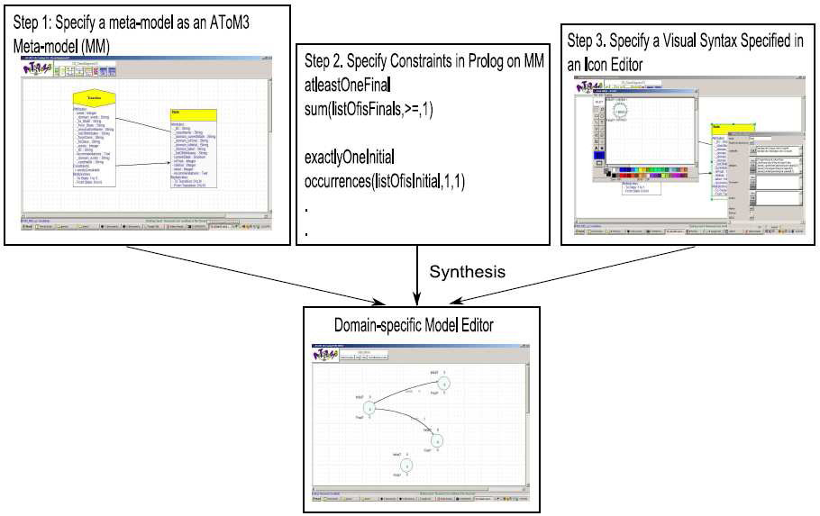
The AToM³ example of FSM: A Domain-specific Model Editor with Prolog Model Completion Rules

Slide 19
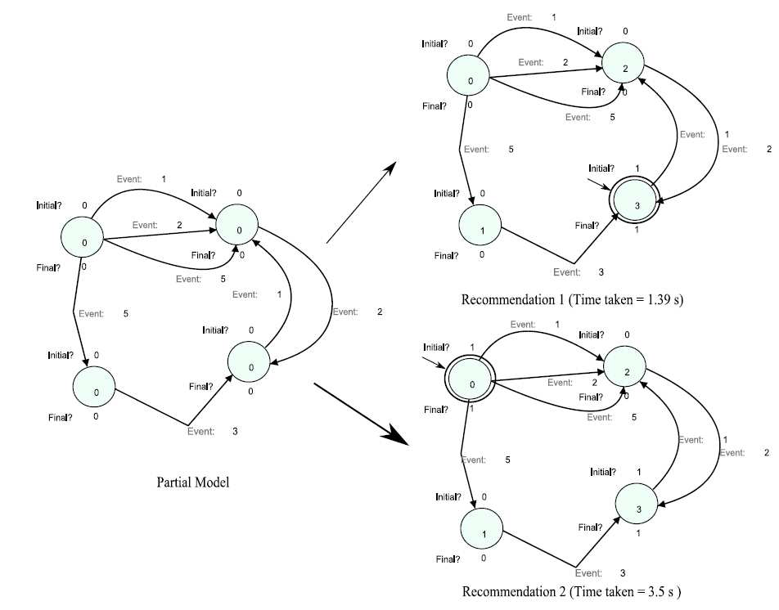
Model Completion example of the AToM³ FSM

Slide 20
A SWRL rule example
A UML state chart finite state machine based on the AToM³ example
  For comparison purpose
    To Shuttle, SWRL rule source is open,
      can be translated from in-model constraints
      or from third-party libraries
  As a test case
  UML2 State Machine editor is bundled in Eclipse Ganymede

Slide 21
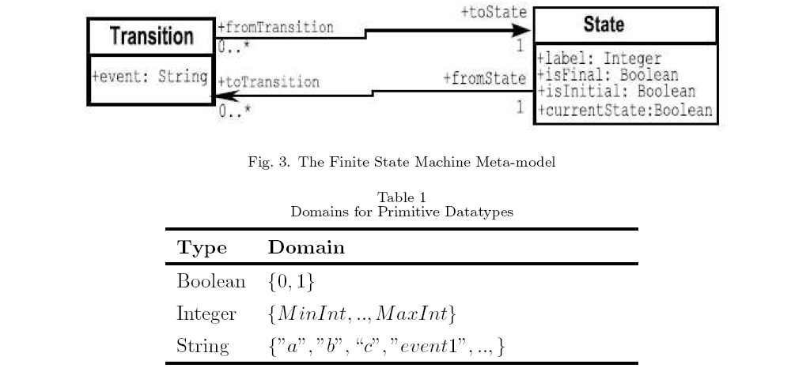
Meta-model of the AToM³ example

Slide 22
Rules correspondent to the meta-model
UML diagram part
  By UML to RDF converters/transformers?
    Duet (http://projects.semwebcentral.org/projects/codip/)
      Support ONLY older version 1.3/1.4 of UML
    UML 1.3 (http://infolab.stanford.edu/~melnik/rdf/uml/), State Machine (http://infolab.stanford.edu/~melnik/rdf/uml/uml-state-20000507.rdf) meta-model in RDF is available
    Eclipse Atlas Transformation Language (ATL) UML2OWL transformation (http://www.eclipse.org/m2m/atl/usecases/ODMImplementation/)
      Unknown error in processing the conversion
  Finally manual transformations with model completion recommending scenarios

Slide 23
Rules correspondent to the meta-model (cont'd)
Table part - manually converted rules
  Boolean as xsd:boolean
  Integer as xsd:integer
  String as
DatatypeProperty( #event range( oneOf( “a” “b” “c” “event1” ... ) ) )

Slide 24
Manually combined rules from both diagram and table part
For diagram classes
  Class( State 'partial'
restriction( #label cardinality(1) )
restriction( #label allValuesFrom(xsd#integer) )
restriction( #isFinal cardinality(1) )
restriction( #isFinal allValuesFrom(xsd#boolean) )
restriction( #isInitial cardinality(1) )
restriction( #isInitial allValuesFrom(xsd#boolean) )
restriction( #currentState cardinality(1) )
restriction( #currentState allValuesFrom(xsd#boolean) )
)

Slide 25
For diagram classes (cont'd)
  Class( Transition 'partial'
restriction( #event cardinality(1) )
restriction( #event someValuesFrom( oneOf( “a” “b” “c” “event1” ... ) ) )

Slide 26
For diagram associations (including explicit and implicit navigability & cardinality)
ObjectProperty( toState Functional domain(#Transition) range(#State) )
ObjectProperty( toTransition InverseFunctional domain(#State) range(#Transition) )
ObjectProperty( fromState inverseOf(#toTransition) Functional )
ObjectProperty( fromTransition inverseOf(#toState) InverseFunctional )

Slide 27
For the Prolog constraint rules
Correspondent SWRL rules maybe (given only one machine per diagram):
  AtLeastOneFinalState: sum(listOfisFinal,>=,1)
fsm:FinalState( ?x ) ⇒ swrlb:member( ?x, ?fslist )
builtIn(
swrlb:booleanNot,
swrlb:empty( ?fslist ), 'true' )
shuttle:subLabel( ?x, 'final' ) ^ shuttle:subLabel( ?x, 'state' ) ^ shuttle:subLabel( ?x, 'false' )
⇒ builtIn(
swrlb:booleanNot,
fsm:FinalState( ?x ), 'true' )

Slide 28
For the Prolog constraint rules (cont'd)
  exactlyOneInitial: occurrences(listOfisInitial,1,1)
fsm:InitialState( ?x )
⇒ builtIn(
swrlb:booleanNot,
fsm:InitialState( ?y ), 'true' )
shuttle:subLabel( ?x, 'initial' ) ^ shuttle:subLabel( ?x, 'state' ) ^ shuttle:subLabel( ?x, 'false' )
⇒ builtIn(
swrlb:booleanNot,
fsm:InitialState( ?x ), 'true' )

Slide 29
For the Prolog constraint rules (cont'd)
  alldifferent: all_different(listOfVariables)
fsm:State( ?x ) ^ fsm:label( ?x, ?a ) ^ fsm:State( ?y ) ^ fsm:label( ?y, ?a )
⇒ sameAs( ?x, ?y )
RDF-style lists are NOT supported by OWL-DL, so we have to deal with them specifically

Slide 30
Scenarios of recommendings
New element recommending
  Recommending "AtLeastOneFinalState"
Modified element recommending
  Partial modification
  Deletion

Slide 31
Process of model completion recommending
Pre-modeling knowledge base construction
  Meta-model axioms + constraint rules
Incremental modeling:
  Empty model or
  Current element binding → KAON2 axiom building →
Rule triggering
  KAON2 (OWL-DL)/Shuttle rule inference → propagating inference results upward

Slide 32
Process of model completion recommending (cont'd)
Recommendation activating:
  inference results on MPM →
  new element extraction / current element binding from results →
  recomm. (completion) model construction →
  hint activation →
  recomm. model displaying
Reaction to applying/denying recommendation

Slide 33
Nested (recursive) MPM-PM rule triggering/recommending
Hierarchical PMs
  Applied with hierarchical MDA inference
  For reusable and scalable PM rules
Downward triggering
  MPM→PM
  PM→PM
  antecedent→consequent
  Unconditional fact (OWL fact)

Slide 34
Nested (recursive) MPM-PM rule triggering/recommending (cont'd)
Upward recommending
  PM→PM
  PM→MPM
  consequent→antecedent
  Unconditional fact

Slide 35
Open (unbounded) domain inference
Compared to AToM³'s closed (pre-compiled) domain inference
  More flexible & scalable for usual documents with heterogeneous concepts
Heterogeneous concept inference
  ex. coexisting UML State Machine & other (application) domain concepts
  For the highest scalability
    Various inference result recommendations depending on the scope of MPM

Slide 36
Open domain inference (cont'd)
Open model element bindings
  Exhaustive (wildcard) binding
  To RDF object/property/subject
  To SWRL variables
  To other domains to form multiple MPMs

Slide 37
Open domain inference (cont'd)
Open editor (MPM) rules
  Native editors
    From editor code/API
    UML2 State Machine editor example
      GMF editor definitions as MPM
  Potential editors
    From common PM tagging
    The FSM-over-UML2 example
      FSM rules as MPM

Slide 38
MPM tagging
For native MPM
  Extracting GMF editor rules...
For potential MPM
  By ontology mapping
  Firstly parsing ontology for concept mapping
    ex. parsing user-given FSM rules

Slide 39
Built-in PMs
SWRL PM
  Handling variable binding to model elements
    Exhaustive (wildcard) binding
  Handling RDF-style list related SWRL built-in atoms
    swrlb:member, swrlb:empty, etc.
RDF PM
  Handling RDF-style lists
    List implies collection of model elements
  SWRL_PM↔RDF_PM triggering/recommending
  Model element bindings for object/property/subject

Slide 40
Built-in PMs (cont'd)
Shuttle PM (MPM)
  Handling complex label text issues
PM priority to handle contradiction
  For now, Shuttle PM
> native MPM(s)
> potential MPM(s)
> other built-in PMs

Slide 41
Built-in inference
Description logic inference: Using KAON2's built-in inference API
  Equivalence of descriptions
  Satisfiability of descriptions
  Subsumption of descriptions

Slide 42
Research topics
Inferring model via Concept mapping technique (with client-server collaboration)
Generating rules from GMF editor definitions for model completion recommendation
Extracting GMF editor rules for model completion recommendation without editor definitions
III. MDA-based inference for model completion recommendation visualization

Slide 43
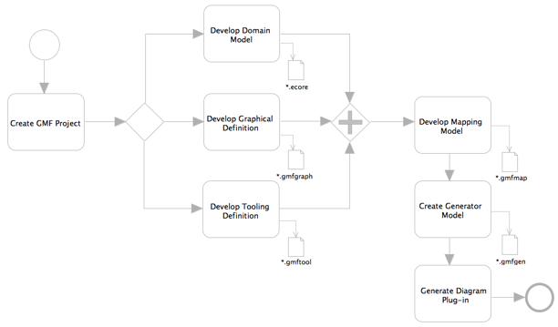
Generating rules from
GMF editor definitions for model completion recommendation

Slide 44
Generating rules from GMF editor definitions for model completion recommendation (cont'd)
GMF editor definitions
  Domain Model Definition
  Graphical Definition
  Tooling Definition
  Mapping Definition
Model completion recommendation – rule inference result recommendation visualization

Slide 45
Research topics
Inferring model via Concept mapping technique (with client-server collaboration)
Generating rules from GMF editor definitions for model completion recommendation
Extracting GMF editor rules for model completion recommendation without editor definitions
III. MDA-based inference for model completion recommendation visualization

Slide 46
Extracting GMF editor rules for model completion recommendation without editor definitions
When editor definitions are not available
  ex. hidden source
Extracting by...
  Is there any right-prepared rum-time editor API?
  Or reverse engineering / code mining?
A universal solution

Slide 47
Tracing bundled GMF editor code
UML2 editors
  Beginning with palette creation tool title (Messages.(...)CreationTool_title)
    Not easy to get the bound view through creation tools
  Or get model element name & view via the element type registry?
    Studying GMF Extensible Type Registry
Other simple example editors
  The simple digital logic editor

Slide 48
Tracing bundled GMF editor code (cont'd)
Investigating: element title in pallete → creation tool → element EditPart view (without EditPart model, just for possibly temporary recommendations)
Studying GMF Extensible Type Registry
Code-let prototype

Slide 49
Logical and physical recommendations
Logical recommendations
  Rule inference results
Physical recommendations
  Results to be displayed
  Using recommendation factory for adapting various displaying techniques
    ex. cloned, gray-scale or accessibility styles
For prototype development & future extension...

